Slide 1
Stress and the Liver De-Stressing Techniques
a presentation by Hakim M. Salim Khan

Slide 2
College of Medicine and Healing Arts 2016
Hakim M. Salim Khan
M.D.(M.A) M.H. D.O.
Founder and Principal
Telephone
(+44) (0)116 273 86 14
E-mail
admissions@CoMHA.org.uk
Website
www.CoMHA.org.uk

Slide 3
College of Medicine and Healing Arts 2016
Hakim M. Salim Khan
M.D.(M.A) M.H. D.O.
President of
Website and Contact Form: www.gni-international.org
Telephone: (+44) (0)207 821 0255

Slide 6
Definition of Stress
Stress can be defined as the strain on an individual’s experiences when he or she responds to stimuli which cause potentially negative physiological or psychological consequences.
In other words, an individual who is experiencing a stressful situation may display physical, mental or behavioural symptoms which may be stress related.

Slide 7
Symptoms of Stress
Psychological | Behavioural | Physical
Tension | Over-eating | Headaches and migraines
Anxiety | Over-drinking | Back pains
Worry | Not eating | Stomach disorders
Depression | Absence from work | Hives and skin disorders
Panic | Insomnia | Coughs and colds
Tearfulness | Taking tranquilisers | Gastric ulcers
Pressure | Short-temperedness | High blood pressure
Inability to relax | Unusual aggression | Heart disease
Feeling overwhelmed | Unusual impatience | Asthma
Loss of confidence | Switching off | Fatigue and exhaustion
Self-doubt | Opting out | Muscle tension

Slide 8
Life = Stress ?
‘You will experience stress when you are stressed by stress.’
‘Some definitions make you wonder if merely living will slowly kill you.’
Dr. Duckworth, Personnel Management, April 1986

Slide 9
General Adaptation Syndrome (GAS)
The alarm reaction. (acute manifestation)
The stage of resistance. (subsequent disappearance of acute manifestation)
The stage of exhaustion. (loss of resistance)

Slide 10
‘Fight or Flight’ Reaction The Sympathetic Nervous System

Slide 12
The Sympathetic Nervous System
An emergency system.
Turns off:
Digestive system.
Immune system.
Sleep.
Growth and repair.
Sense of touch.
Increases:
Blood pressure.
Blood viscosity.

Slide 13
‘Rest and Recover’ Response The Parasympathetic Nervous System

Slide 14
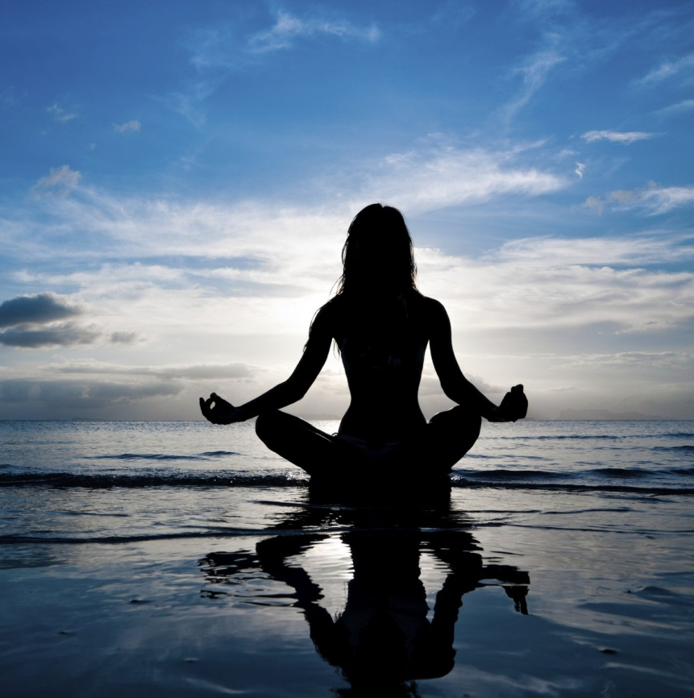

Slide 15
The Parasympathetic Nervous System
Everyday system.
Heart rate slows down.
Blood vessels relax.
Blood pressure normalises.
Nourishment and digestion.
Heal and regenerate the body.
Anabolic, rebuilds the body and stores nutrients
Increased immune activity, digestion, and urinary function.
These organs include the liver, pancreas, stomach, intestines, kidneys, and bladder.
The parasympathetic nervous system, when activated by rest, relaxation and positive thinking, is essential for the elimination of wastes, emotional wellbeing and healing.

Slide 16
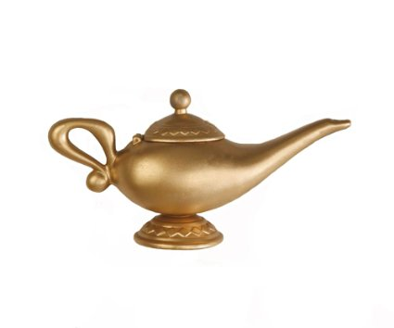
Innate Heat
Before Stress
During Stress
After Stress
Radical Moisture

Slide 17
Stress According to Tibb
Human life and health is compared to an oil lamp that comprises of Innate Heat (the flame of life) and Radical Moisture (the oil that feeds the flame).
Preservation of these two factors are the necessary components to health.
In a constantly stressful lifestyle, the person is ‘burning the candle at both ends’ and excess ‘oil’ is used up too rapidly.
This can be manifest outwardly or the individual can ‘burn on the inside’.
After a period of stress, a lot of ‘oil’ has been used up thus the ‘flame of life’ dwindles.

Slide 18
Stress and the Liver

Slide 19
Functions of the Liver
One of the primary and main organs of the body.
Called ‘the general of the army’ in TCM.
Functions:
Detoxification.
Enzymes and digestive juices.
Hormone and protein production.
Blood sugar storage.
Immune cell activation.
Storage of vitamins and iron.

Slide 20
Symptoms of Liver Imbalance
Gas, bloating and constipation.
Haemorrhoids.
PMS, breast tenderness for ladies.
Irritability.
Insomnia (1am – 3am).
Irregular stools.
Poor fat digestion.

Slide 21
Stress, Toxicity and the Liver
A sluggish liver means less detoxification.
More toxins in the body means more inflammation.
Inflammation stresses the adrenal glands to make cortisol.
Adrenal glands eventually burn out causing anxiety and depression.

Slide 22
Stress, Lactic Acid and the Liver
Lactic acid is produced more during stress.
This is usually processed by the liver into glucose.
Sluggish liver means less lactic acid cleaned up.
Higher lactic acid levels increase levels of anxiety.
Sugar, alcohol and caffeine increase lactic acid levels.
So sluggish liver contributes to anxiety.

Slide 23
“They [Chinese] say that although the heart stores the spirit, it is the liver that can unbalance the spirit.
This can work both ways so that emotional stress can impair the functions of the liver, and disharmony in the liver can have adverse effects upon the emotional state.
This can lead to irritability, anxiety and deep depressions with suicidal tendencies. You may have heard the phrase, ‘he is a bit liverish today’. In other words stay away as this person is in a very bad mood.”
Page 33, The Liver Cleansing Diet by Dr. Sandra Cabot

Slide 26
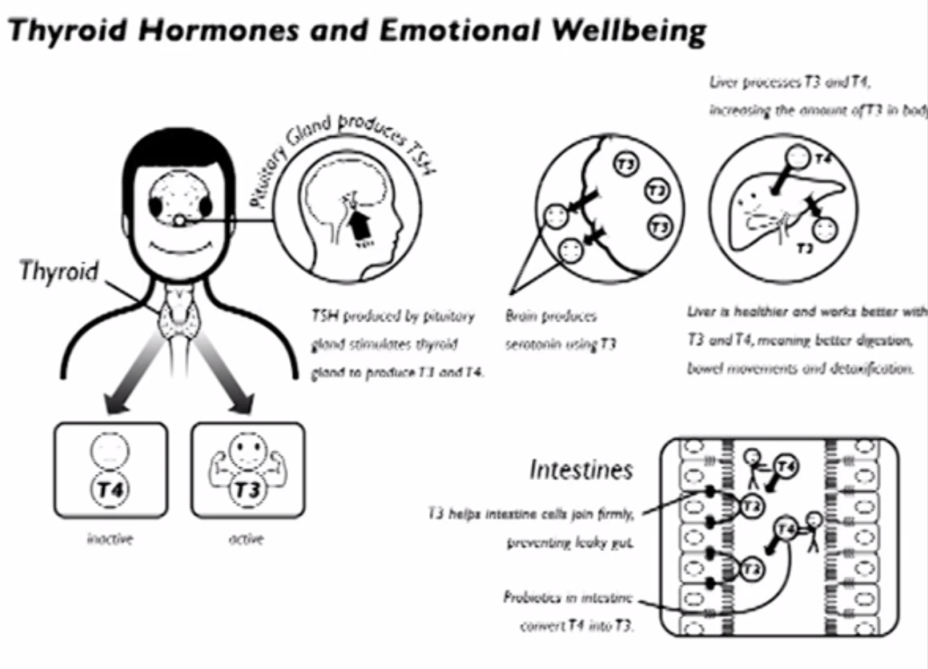

Slide 27
Stress and the Iris

Slide 28
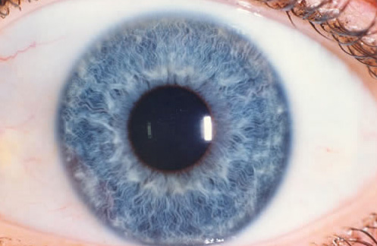
The Lymphatic Iris

Slide 29
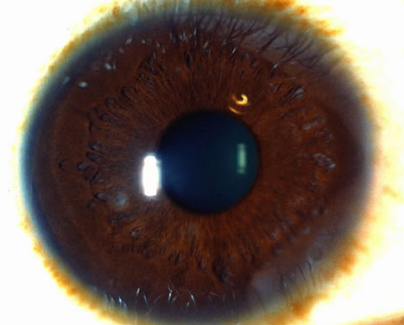
The Haematogenic Iris

Slide 30
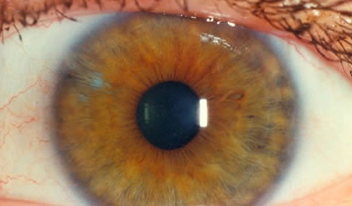
The Biliary Iris

Slide 31
http://www.bernardjensen.com/Weakened-Adrenal-Glands-and-Fatigue-A-Roadmap-in-the-Iris_b_3.html

Slide 32
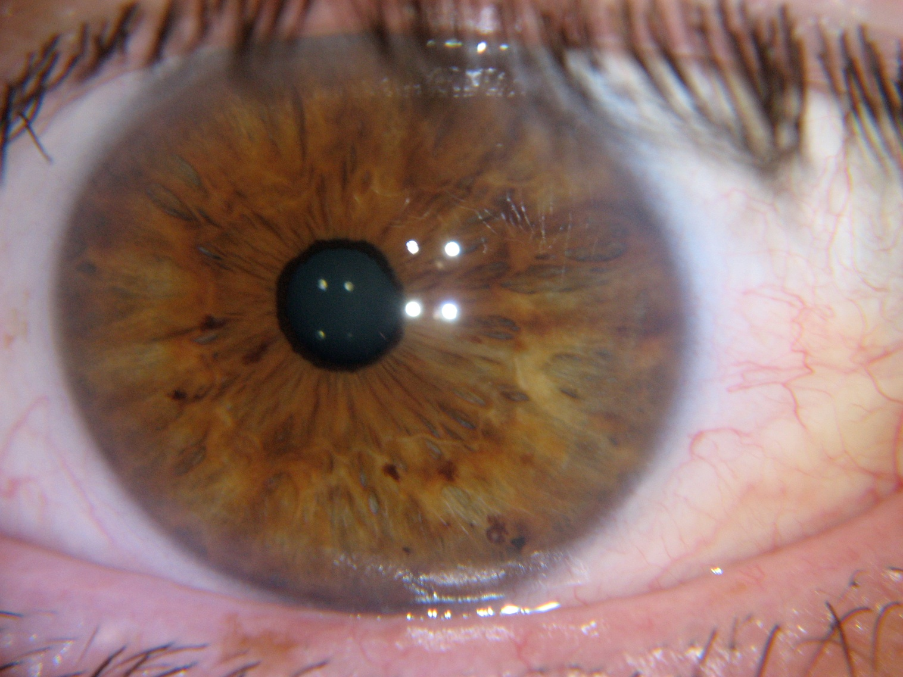
http://www.behealthy.com.au/aturopathy/iridology/iris-pics/

Slide 33
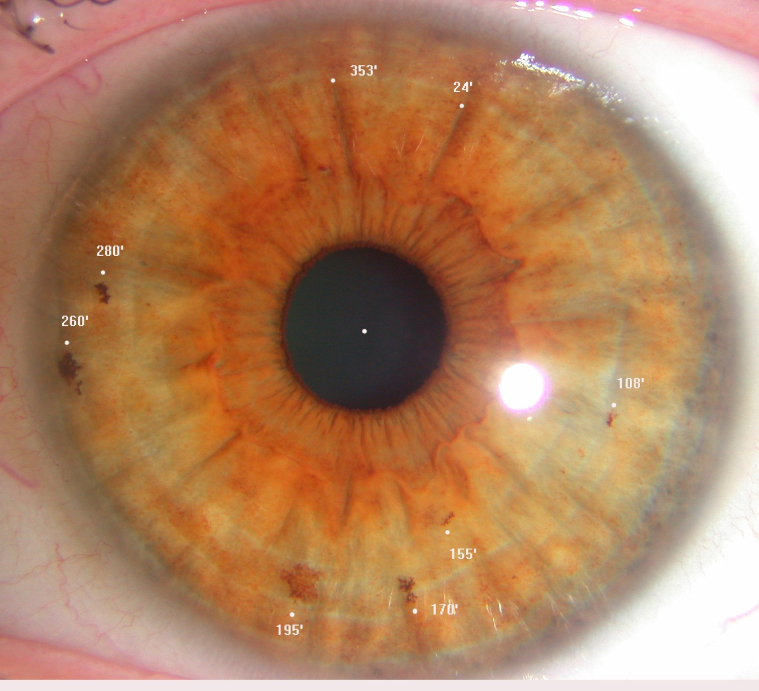
http://sivasanta.blogspot.co.uk/2011/11/mixed-biliary-iris-constitution.html

Slide 34
De-Stressing Techniques

Slide 35
Hot
Type A Personality
Yang
Dry
Moist
Type B
Personality
Yin
Cold

Slide 37
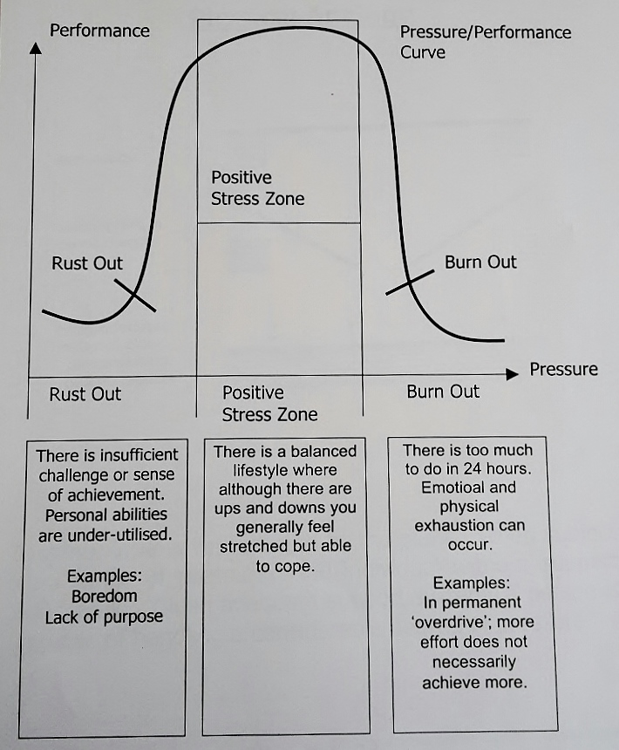

Slide 38
Life Balance
Air and environment.
Food and beverages.
Emotions.
Activity and rest.
Sleep and wakefulness.
Retention and elimination.

Slide 39
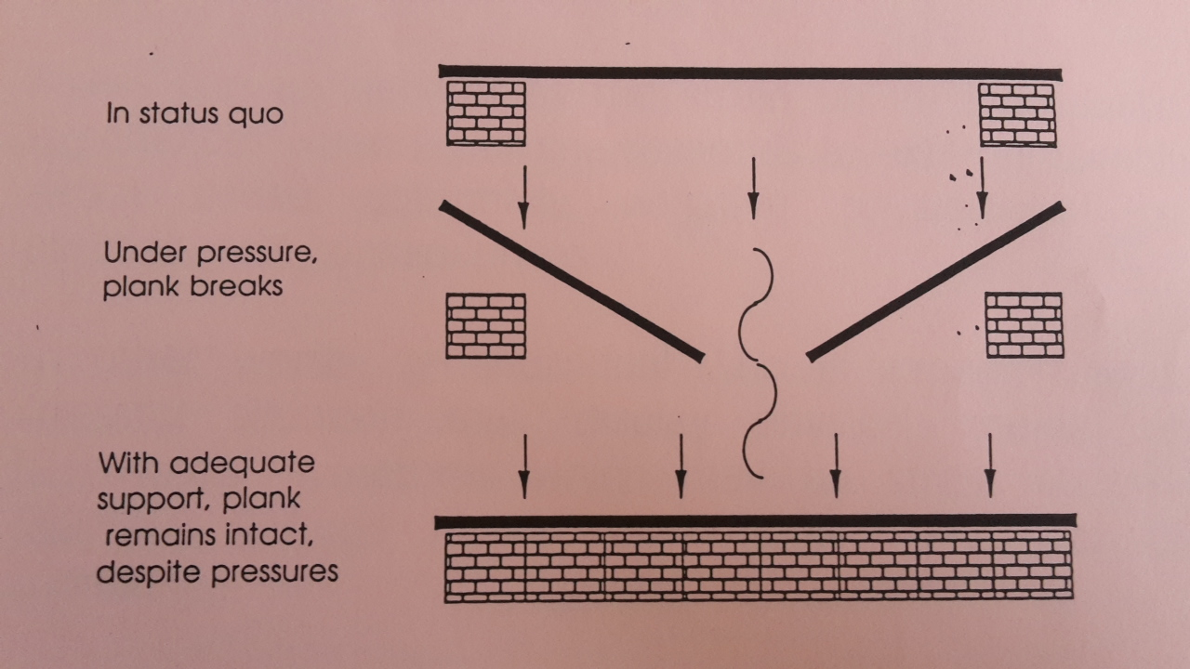

Slide 40
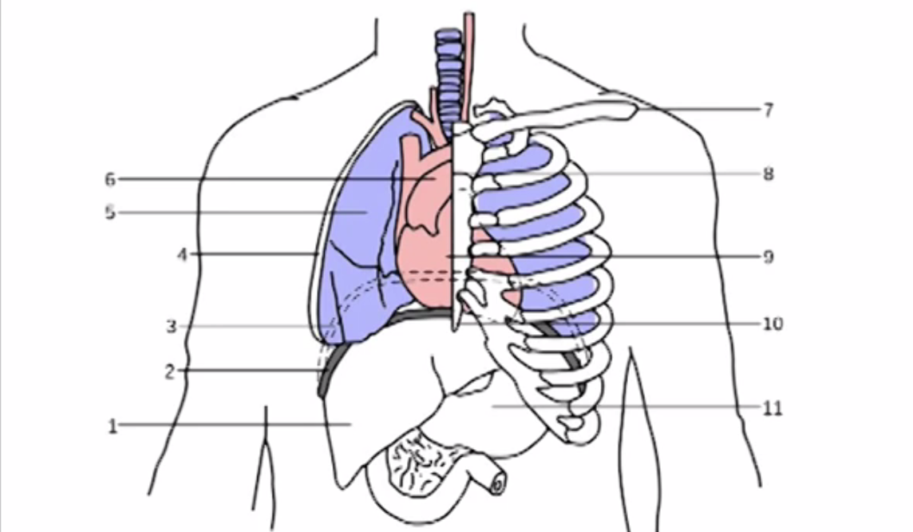
Breath and Liver Massage

Slide 41
Nutritional Support
Antioxidants, e.g. berries, beetroot.
Fibre to bind onto toxins.
Vitamins: C and B.
Minerals: potassium and magnesium.
Bitter greens.

Slide 42
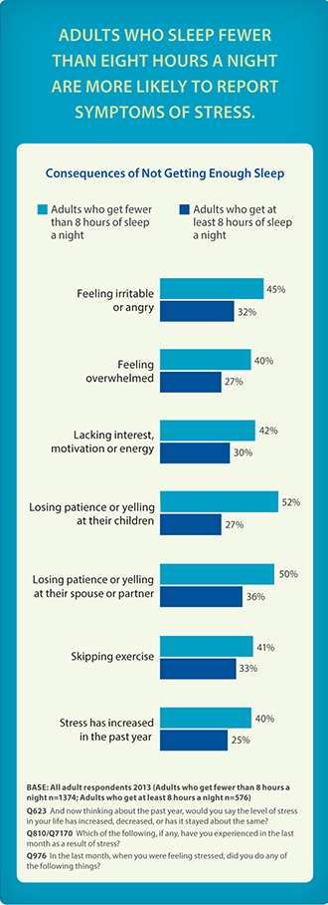
http://www.apa.org/news/press/releases/stress/2013/sleep.aspx

Slide 43
Importance of Sleep in Managing Stress
Get adequate sleep: A good night's sleep makes you able to tackle the day's stress more easily. When you are tired, you are less patient and more easily agitated, which can increase stress. Most adults need 7-9 hours of sleep per night. Practicing good sleep hygiene along with stress-lowering tactics can help improve your quality of sleep.
http://www.webmd.com/sleep-disorders/guide/tips-reduce-stress

Slide 44
Herbal Support
Adaptogenics: ashwaganda, shatawri.
Liver support: dandelion, milk thistle.
Heart support: saffron, hawthorn.

Slide 45
Social-Emotional Support
Acceptance and place in society.
Positive and loving relationships.
Unconditional Service (Khidma).
Relaxation.

Slide 46
Psycho-Spiritual Support
Positive self-esteem.
Positive thinking.
Muraqabah, meditation or ‘watching over’.
Tafakkur, contemplation of the cosmos.
Dhikr, remembrance of the beloved.
Ma’rifa, understanding our place in the cosmos.

Slide 47
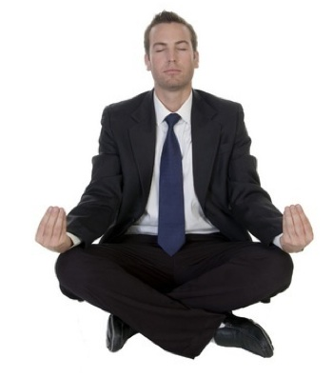

Slide 48
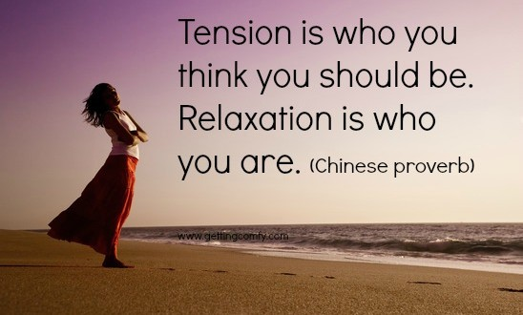

Slide 50
College of Medicine and Healing Arts
Telephone (+44) (0)116 273 86 14
E-mail admissions@CoMHA.org.uk
Website www.CoMHA.org.uk
Guild of Naturopathic Iridologists International
Website and Contact www.GNI-International.org
Telephone (+44) (0)207 821 02 55

